Slide 1
Project : Data Center

Slide 2
Summary
Specifications
Task repartition
My work
Final production

Slide 3
Specifications
Protected
Supplied
Secured
Fireproof
Ecologic
Temperature and humidity

Slide 4
Task repartition
Energy
Conception
Security
Fireproof
Temperature and humidity

Slide 5
My Work
Purchase order
Simulation
Production

Slide 6
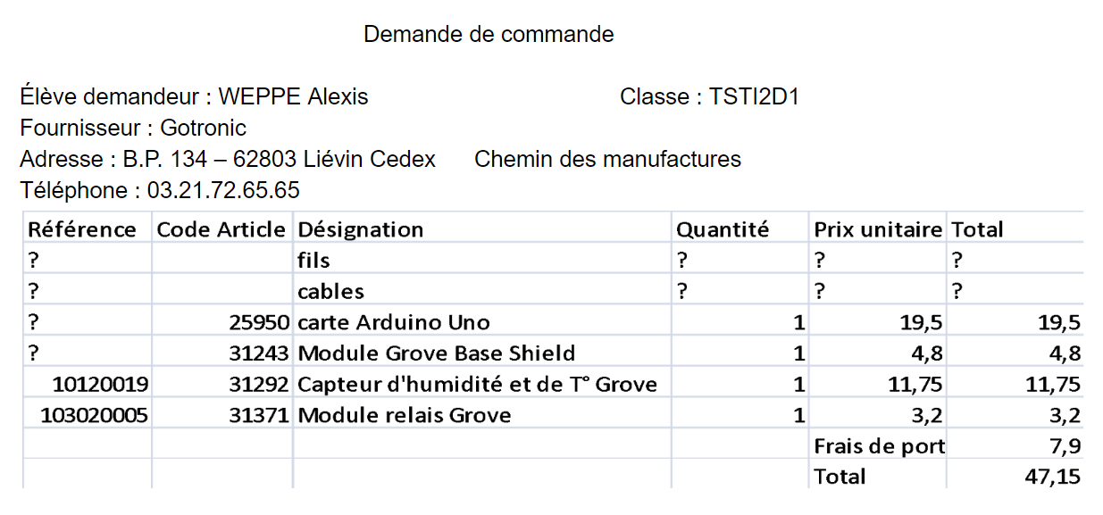
Purchase order

Slide 7
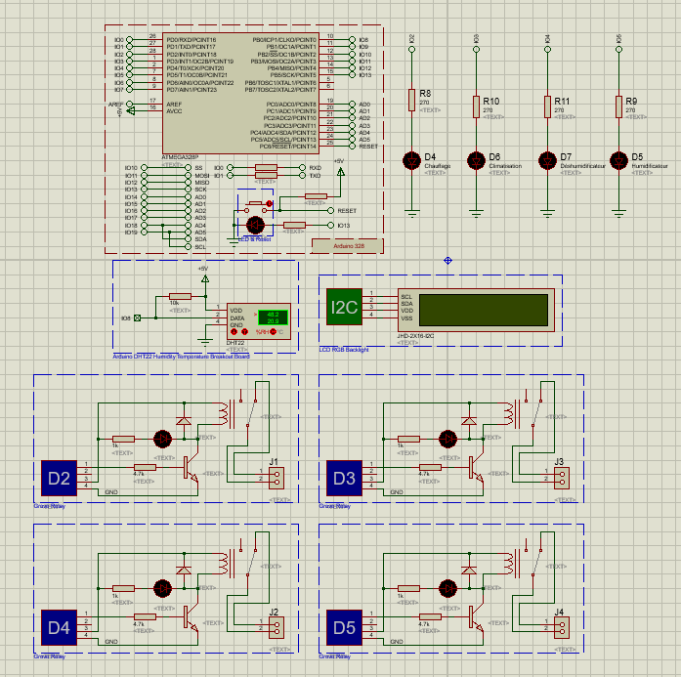
Simulation

Slide 8
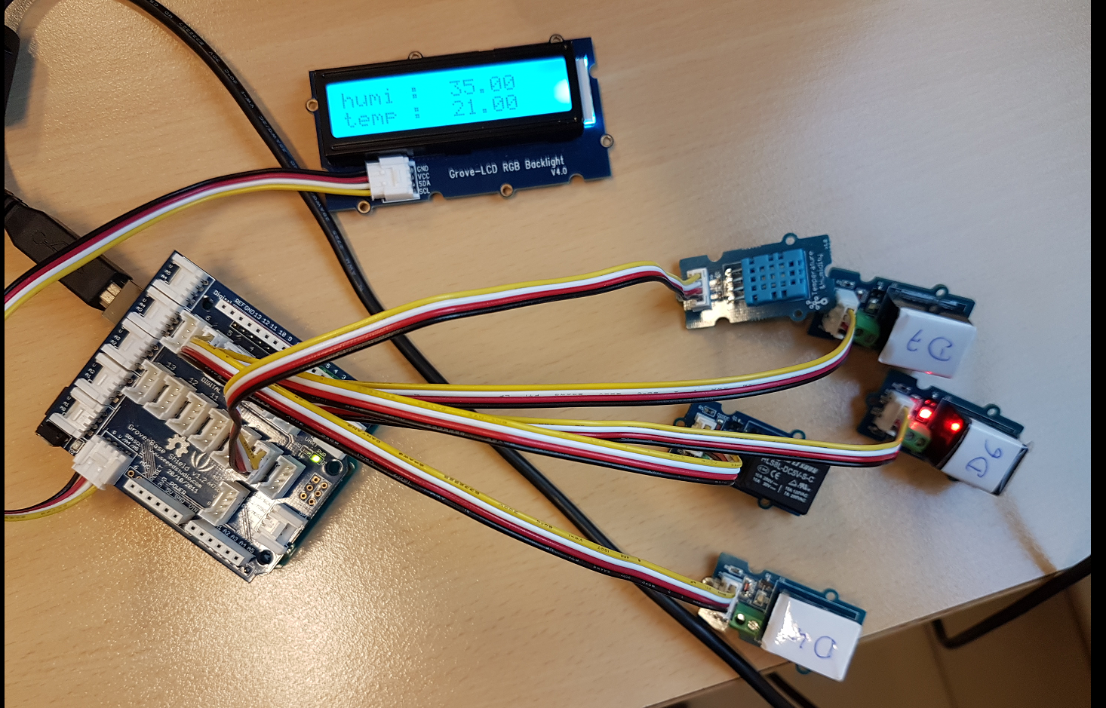
Production

Slide 9
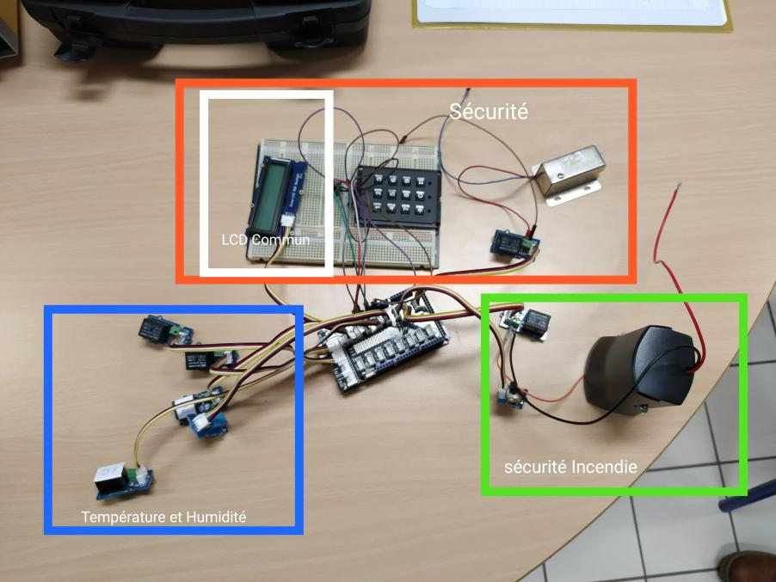
Final Production

